Slide 1

Major Cybersecurity Incidents
CEP 146 Project

Slide 2

Historical Event (Historical Perspective)
Global Case (Global Focus)
Canadian Case (Local Focus)

Slide 3
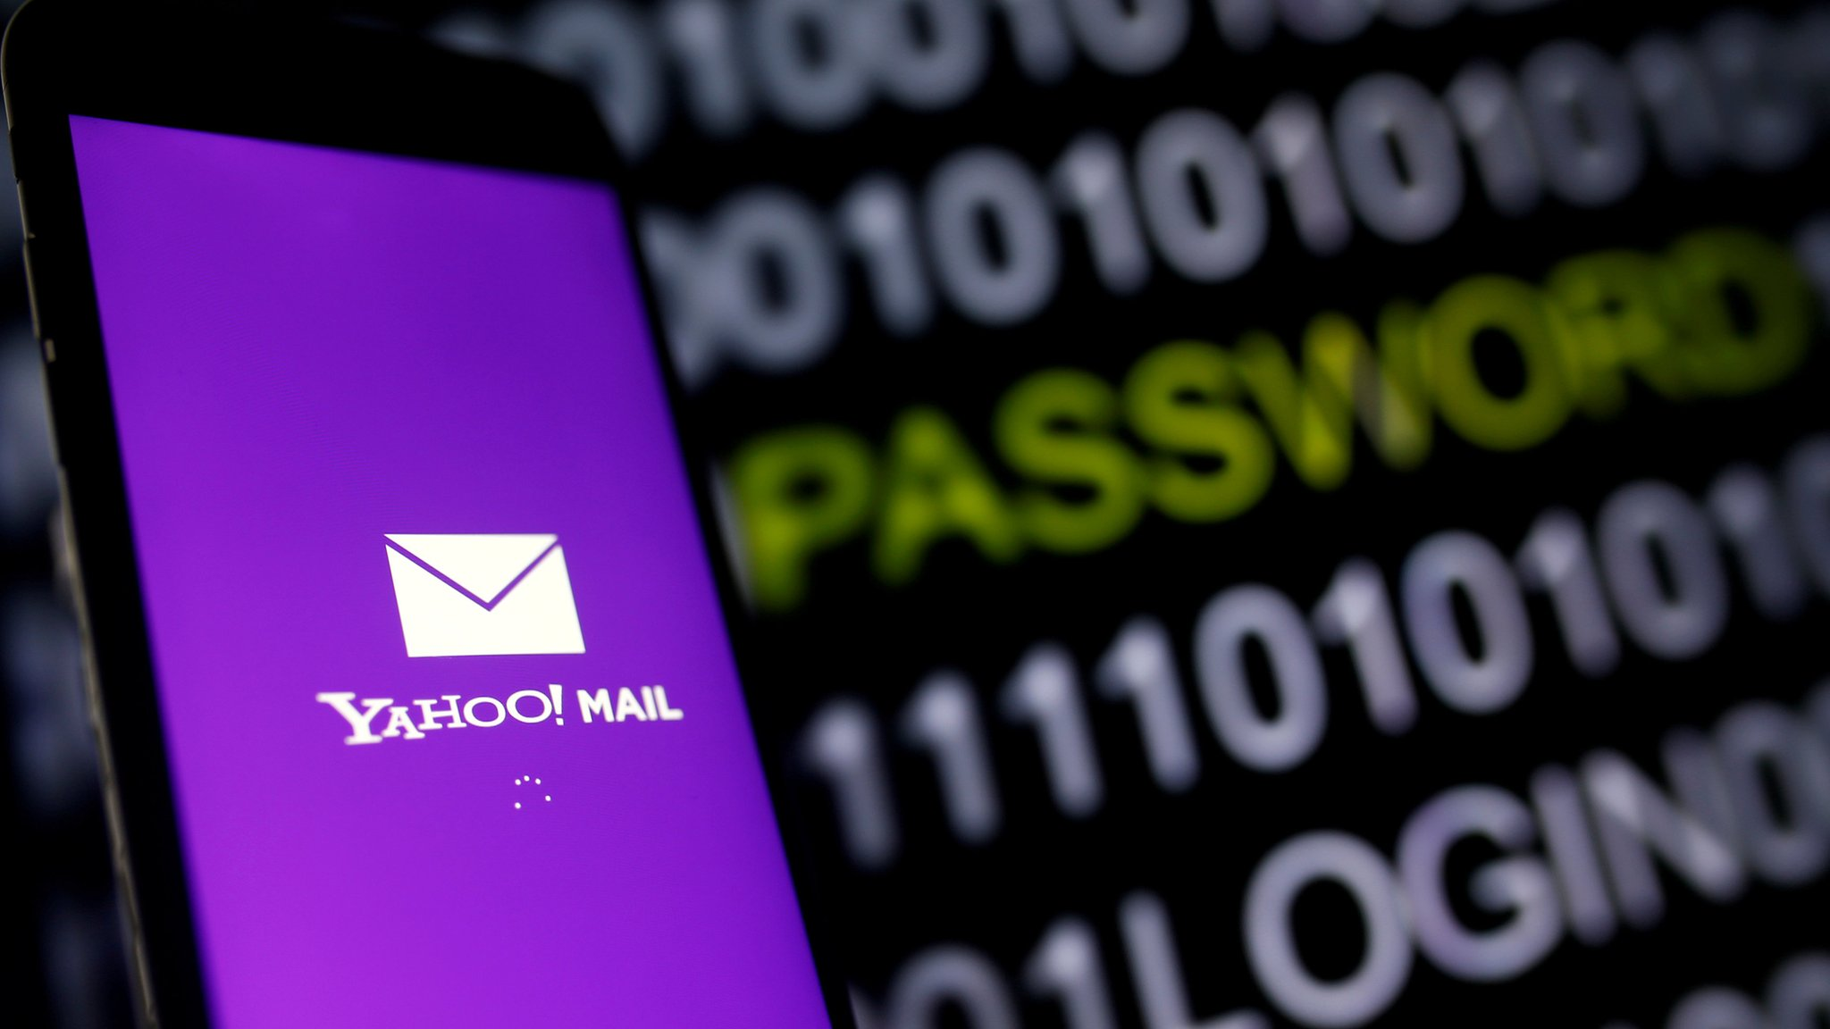

Yahoo Data Breach (2014)
- Over 500 million users affected
- Yahoo revealed the breach two years later
- Linked to Russian hackers (FSB)
- Used phishing emails to steal user data
- Led to loss of trust and lawsuits
- Verizon cut $350M from Yahoo’s sale price
Reference: [Netwrix Community] (https://blog.netwrix.com/biggest-cyber-attacks-in-history "The Largest and Most Notorious Cyber Attacks in History")

Slide 4

-
"WannaCry" attack
(2017)
- Cyberattacks have become more advanced and destructive as technology advanced
- Cyberattacks can have devastating effects that can be felt worldwide
- One of the biggest and most relevant global attacks was the "WannaCry" attack of 2017

Slide 5

- 79 stores closed for a week Hackers
- Demanded $25M, not paid
- Some internal data leaked
- No customer data affected
- Shows rising cyber risks in Canada
(2024)

Slide 6
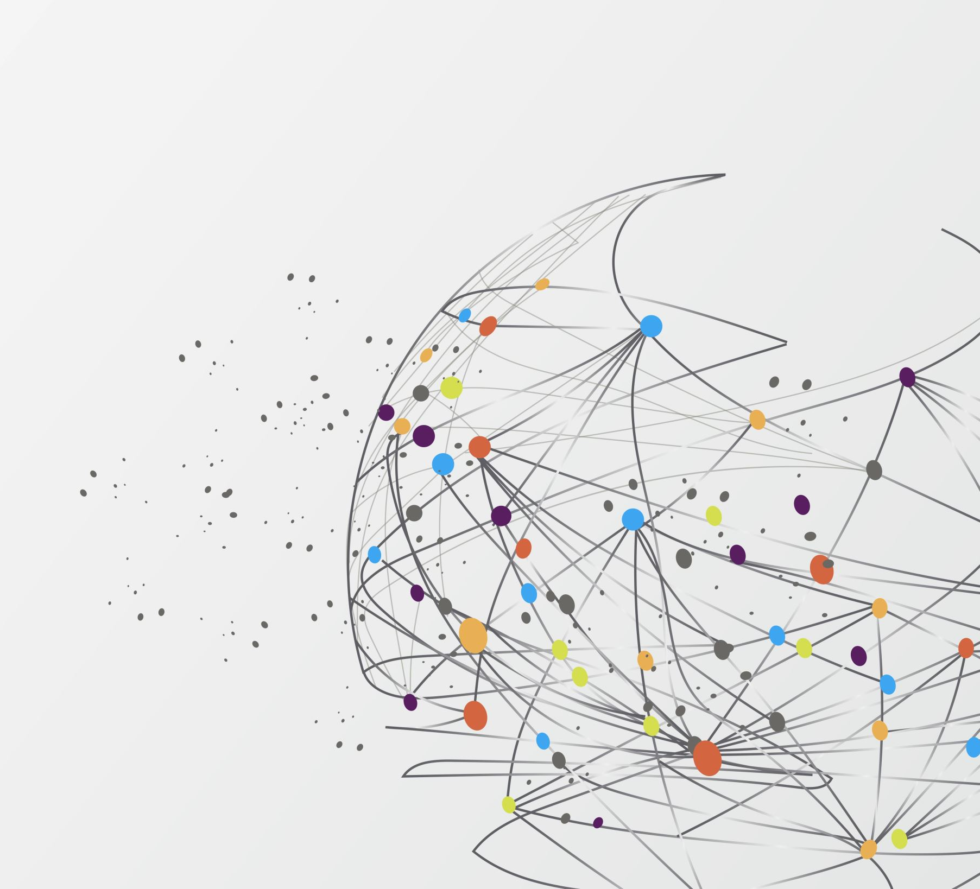
Conclusion
Cybersecurity is one of the most serious global issues today.
Real cases like Yahoo, WannaCry, and Lockbit show how cyber threats affect everyone.
Everyone can be a target — online safety is a shared responsibility.
Companies must improve their systems and protect user data.
Users should be careful with passwords and personal information.
Governments need stronger laws and global cooperation to fight cybercrime.
Cybersecurity is not only about technology but also about awareness and education.
Working together can make the internet safer and more trusted for everyone.

Slide 7

Conclusion

Slide 8
reference
Schrader, D. (2025, August 12). The largest and most notorious cyber attacks in history. Netwrix. https://blog.netwrix.com/biggest-cyber-attacks-in-history
Gatlan, S. (2024, May 21). LockBit says they stole data in London drugs ransomware attack. BleepingComputer. https://www.bleepingcomputer.com/news/security/lockbit-says-they-stole-data-in-london-drugs-ransomware-attack

